Slide 1
URBAN MOBILITY - FAILURE CAPTURE & REPORTING
Prepared for Road Maintenance Forum
Compiled by:
Moegamat Adams (Roads Infrastructure Management department)
7April 2022

Slide 2
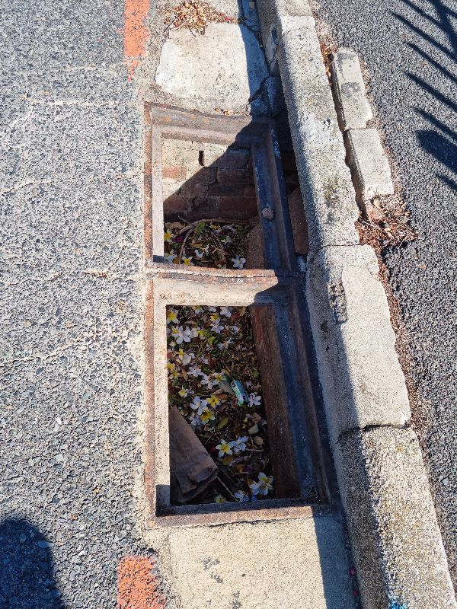
Purpose
ROADS ORDINANCE NO. 19 OF 1976, section 7: Maintenance of public roads and paths
Municipal Finance Management Act: Accountability
Protect our assets
Accessible network for all road users
Safe passages free of hazards

Slide 3
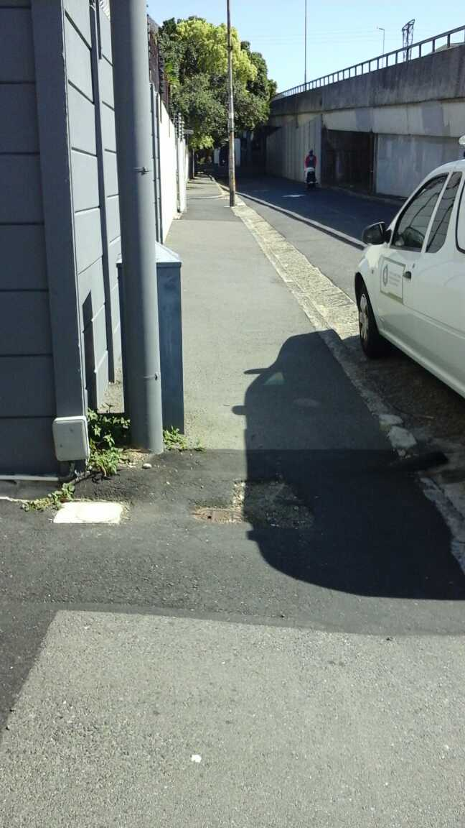
Background
Pre-2000
Complaints board with book
Since 2000
Computer-based complaint system (SAP)
Call centre reference number
C3 notification
2018
SAP with TAMS (Transport Asset Management System)
N notification
Handheld Technology

Slide 4
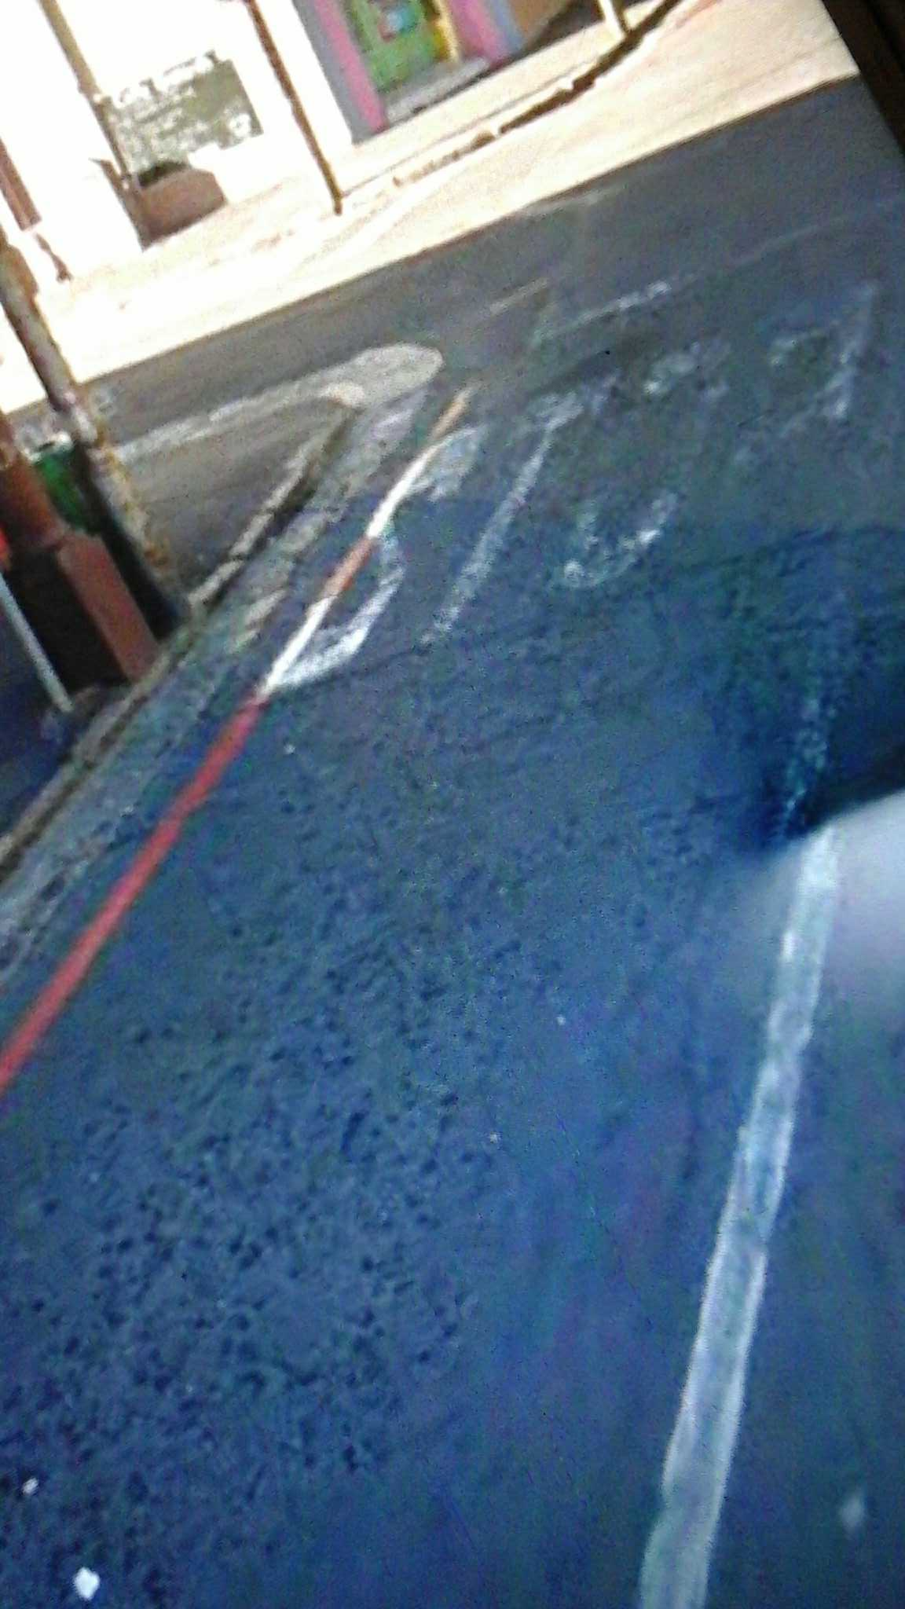
Receiving
Corporate Call Centre
Transport Information Centre
Online platforms
Other

Slide 5
Execution
N or C3 Notification allocated to work centre
Assignment to Foreman
Since 2018 all activities are booked real-time on handheld device

Slide 6
Execution
N or C3 Notification allocated to cost centre
Assignment to Foreman
Since 2018 all activities are booked real-time on handheld

Slide 7
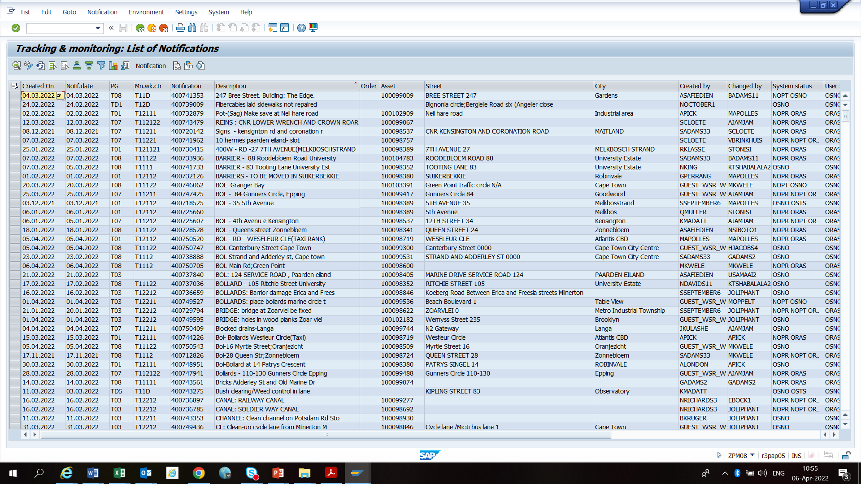
Recording, Monitoring and Quality Control
High Level and detail reports can be drawn from SAP system for Age analysis, cost, progress
Use information in conjunction with dTIMS Pavement Management System to make informed decisions

Slide 8
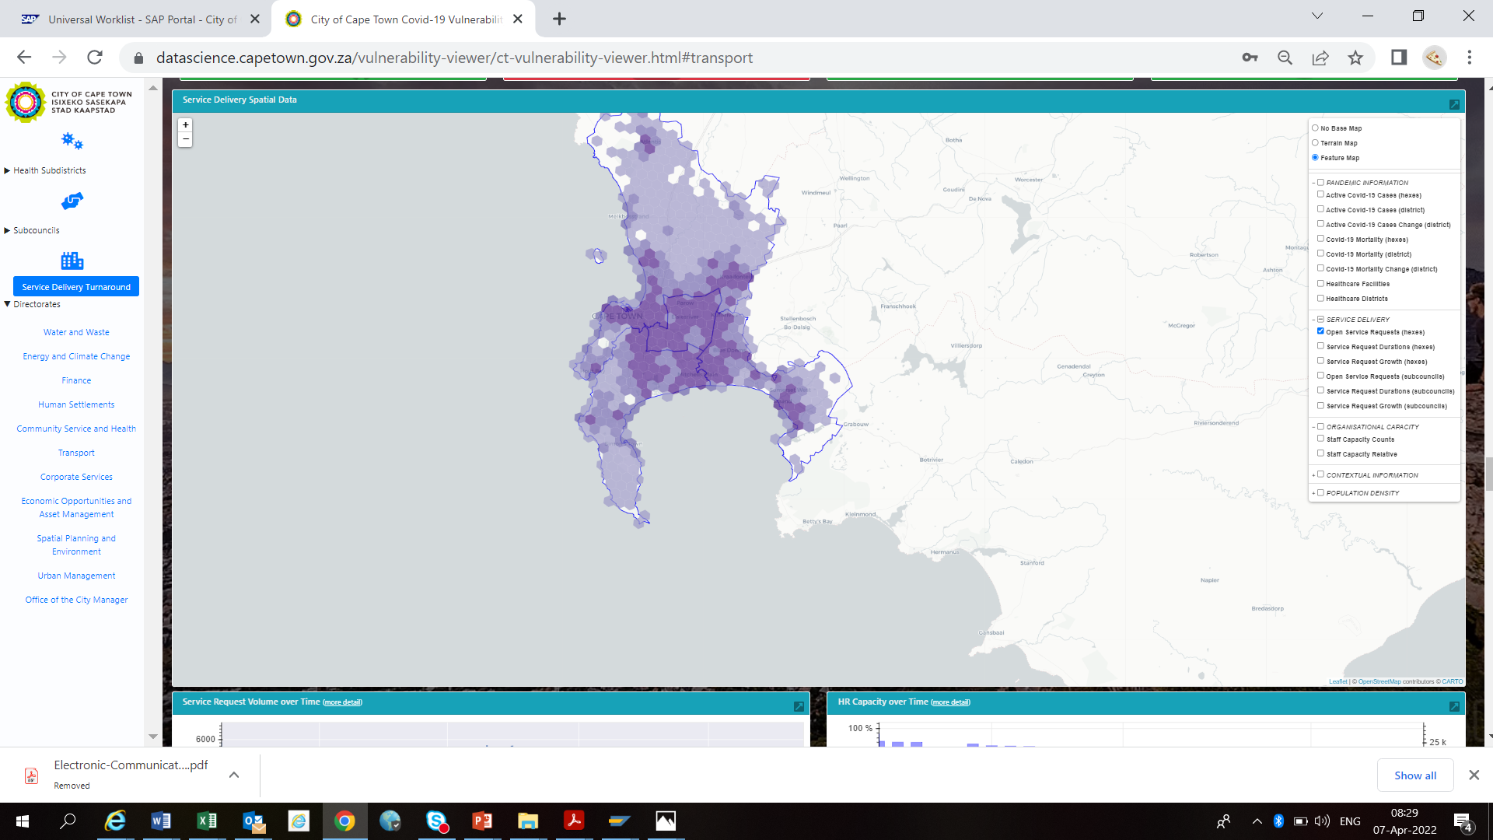
Recording, Monitoring and Quality Control
High Level and detail reports can be drawn from SAP system for Age analysis, cost, progress
Use information in conjunction with dTIMS Pavement Management System to make informed decisions
Future enhancements regarding spatial viewing

Slide 9
THANK YOU

