Slide 1
URBAN MOBILITY - WAYLEAVE PROCESS AND STANDARDS
Prepared for Road Maintenance Forum
Compiled by:
Moegamat Adams (Roads Infrastructure Management)
6 April 2022

Slide 2
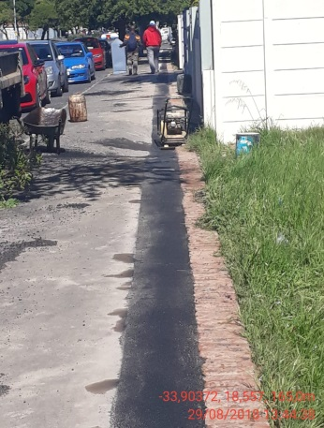
Legislation
BY-LAW RELATING TO STREETS, PUBLIC PLACES AND THE PREVENTION OF NOISE NUISANCES
Section 11(1) EXCAVATIONS IN STREETS
No person shall make or cause to be made an excavation or dig or cause to be dug a pit, trench or hole in a public road except with the written permission of the City
Electronic Communications Act, 2005
Section22 :
Entry upon and construction of lines across land and waterways

Slide 3
Challenges
Poor workmanship
Poor construction and compaction methods
Improper use of materials
Disregard to other existing services
Poorly Controlled Development
Large parts of road and footways rendered unusable during construction
Insufficient time to issue approvals
more than 400 license holders

Slide 4
Solution
Clear guideline to the standards that all applicants must comply with:
‘WAYLEAVE PROCESS AND STANDARDS FOR THE INSTALLATION OF SERVICES IN ROAD RESERVES Oct 2018’
Process Flow - The process to be followed for the application
Provision of Technical Specifications - The minimum construction standards for the installation of telecommunication and services
Need to allocate a dedicated space Monitored departmentally

Slide 5
Flow Diagram 2 - WAYLEAVE APPLICATION & APPROVAL
After resubmission, process can forward directly to Technical Assessment
Applicant submit Wayleave Application to relevant Directorate Refer to Appendix A
Service Department assess application in terms of compliance with Submission Requirements
Service Department to revert back to applicant (via e-mail) on outstanding items / issues pertaining to correctness of submission
Application compliant?
NO
YES
Technical Assessment commences
Technical approval granted?
Wayleave application approved
Refer to Template 6
and
Permit-to-Work prepared
Refer to Template 7
NO
YES
Calculate full cost: Admin Fee, Refundable Deposits and Non-Refundable Payments and advise Applicant accordingly
Refer to Templates 2-5
Applicant to pay fees as per invoicing

Slide 6
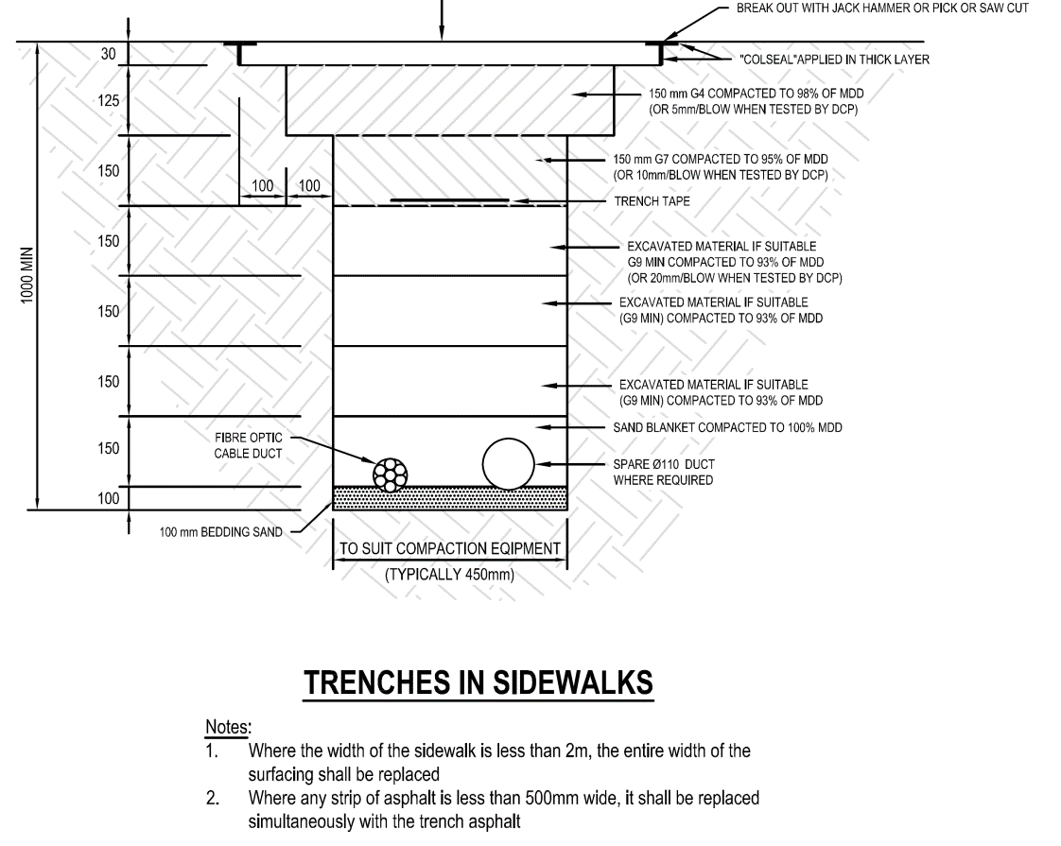
ECSA Registered Engineer
The Network Licensee / Service Owner shall appoint an ECSA registered Civil Engineer to oversee the installation of the network
The appointed Engineer must have sufficient competency in Road Building and Materials.

Slide 7
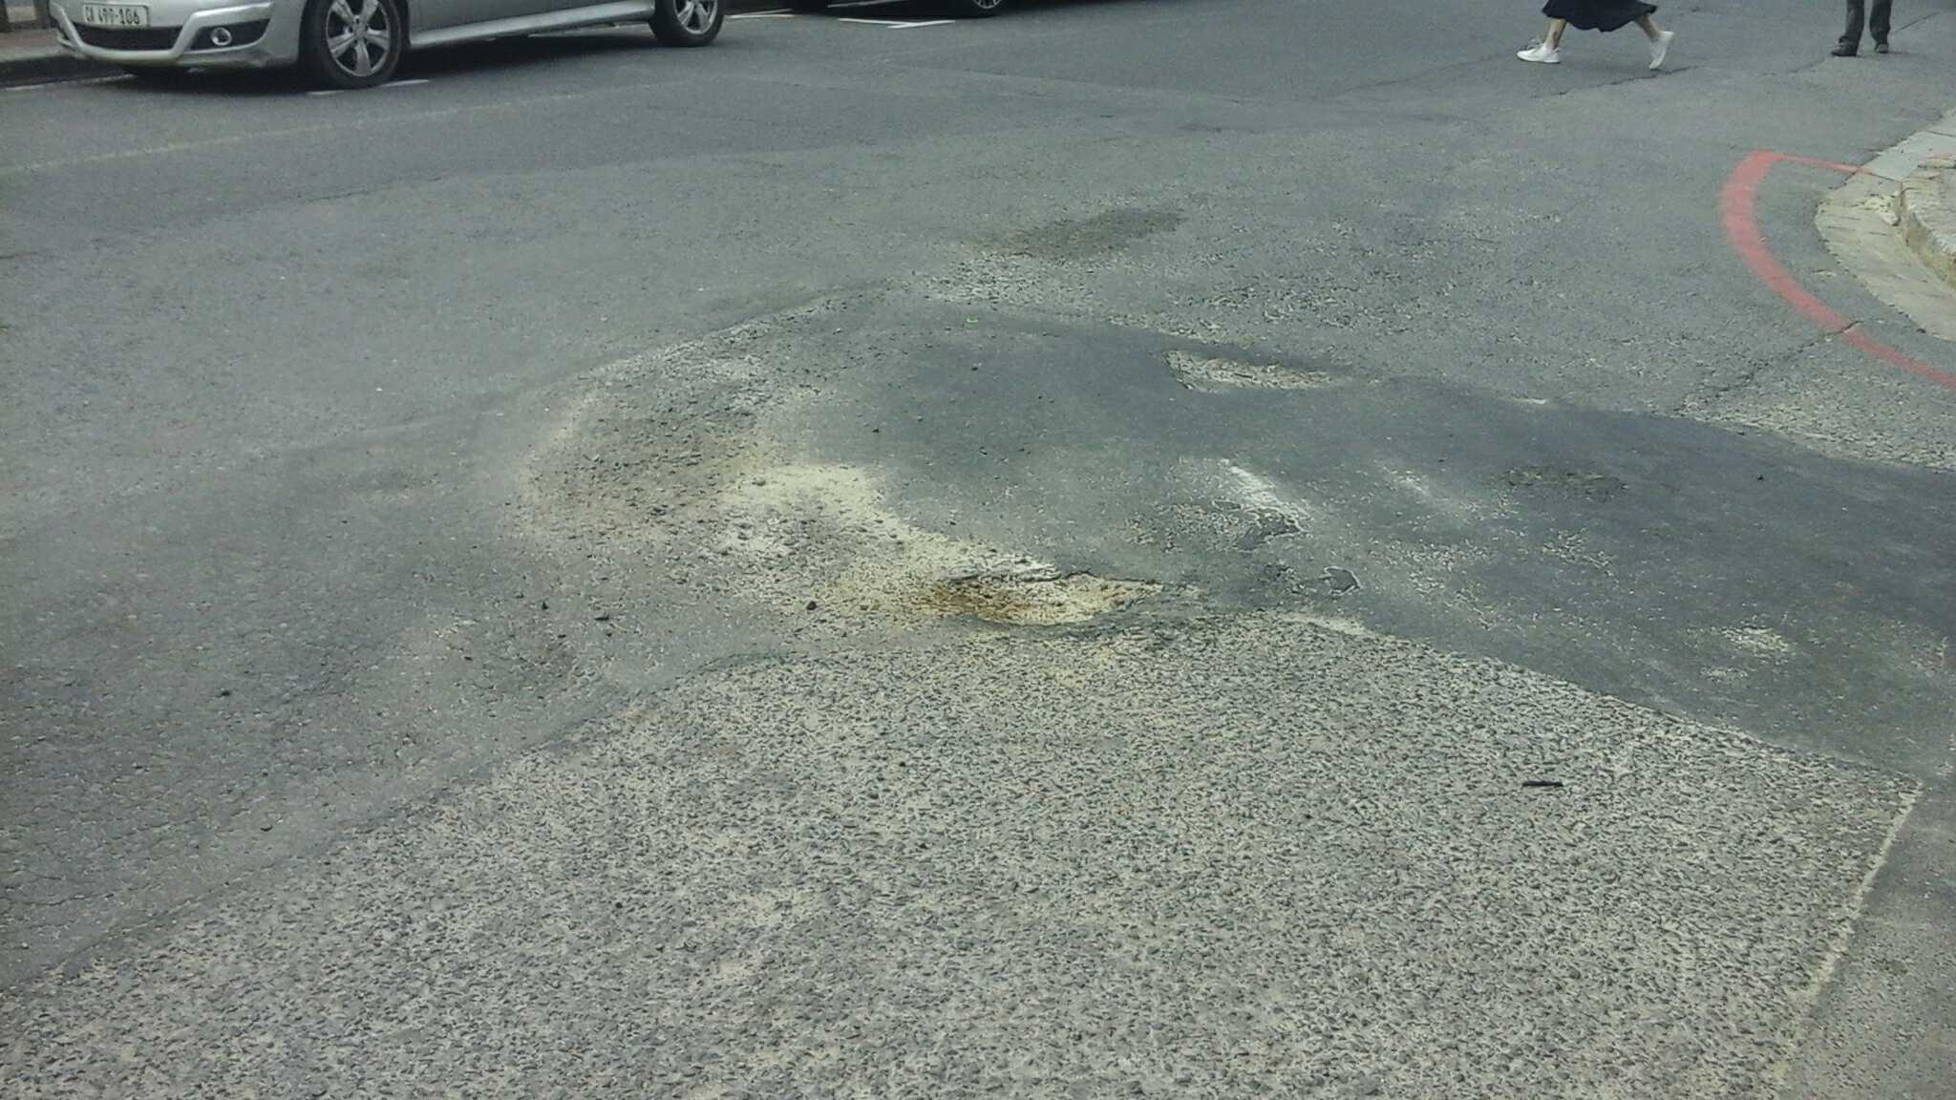
CIDB Registered Contractors
All installations and reinstatements done for or on behalf of a Network Licensee and/or Service Owner shall be undertaken by a CIDB registered contractor with a minimum 3CE designation and with a grading appropriate to the value of the contract.
The appointed Engineer must have sufficient competency in Road Building and Materials to advise regarding the requirements for the trench backfill, layer works and surfacing.

Slide 8
Trenching vs Directional Drilling
No open trenching or micro trenching will be allowed in the roadway without the written permission of the City
All road crossings shall be done by directional drilling.
Thrust boring will not be allowed.
Where conditions do not allow and only with the written permission of the Directorate: TDA will open trenches be allowed.

Slide 9
‘One Trench’ or Co-building Methodology
All Network Licensees and/or Service Owners make use of the same space allocation (One Trench) for telecommunication services in the road reserve.
The maximum permissible space allocation per route for all networks will be 1.0m wide

Slide 10
THANK YOU

