Slide 1
Welcome to the 4th
Road Maintenance Forum
22nd November 2023
sponsored & supported by……..

Slide 2
Welcome
Background
Objectives

Slide 3
RMF Historical Background
07 April 2022 : 1st RM Forum held online
Topics agreed for discussion:
    Systems
    Materials
    Quality
    Laboratories
    Resolutions
    13 panelists ... 348 delegates
05 October 2022 : 2nd RM Forum held online
14 panelists … 275 delegates
  13th April 2023 : 3rd RM Forum held online
    19 panelists … 330 delegates

Slide 4
Objectives of the RMF
Providing a perspective of overarching strategic issues as it affects road maintenance
Promoting best practice - particularly training of emerging contractors;
Co-ordination and linkage with other groupings;
Establishment of task groups with specific national objectives;
Provision of sufficient time for participation/discussion/advice and for social interactions;
Dissemination of new technologies
Provision of a forum for acceptance of technological changes;
Provision of a forum for interaction between theory and practice and for identification of technology development needs

Slide 5
Objectives of the RMF
serve as a forum for the exchange of information and technologies,
to discuss issues of strategic importance to the roads construction industry, focusing on road maintenance.
should enable wider representation and participation from the broader roads industry, particularly urban, rural, provincial authorities, and emerging contractors.
could allow for broader regional representation through playing a facilitating role as a catalyst for technology transfer in the southern African region.

Slide 6
4th RM Forum Programme:
Key-Note Address
Dr Juan José Potti – Founder of International Road Maintenance Day
“The IRMD Initiative – A Review Of Its Evolution and Future Prospects”
André Fabricius
“Roadworks Worker Safety Procedures”
Ms Lalie Louw – SAFCEC
“FEM Statistics”
Mr Contractor (tbc)
“Lessons Learnt in Best Practice in Road Maintenance and Repairs”
Phil Hendricks – Sabita
“Cold Mix Certification Process”
Resolutions, Thanks and Closure – Rudolf Murray (Safcec)

Slide 7

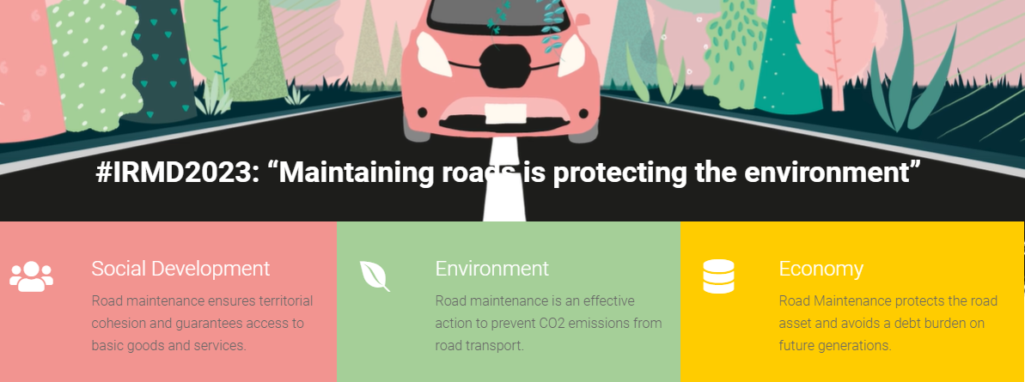
Social Media : #IRMD2023

Slide 8

for joining us.
The CPD reference Number :

Slide 9
Key RMF Outputs leading to possible Resolutions

