Slide 1
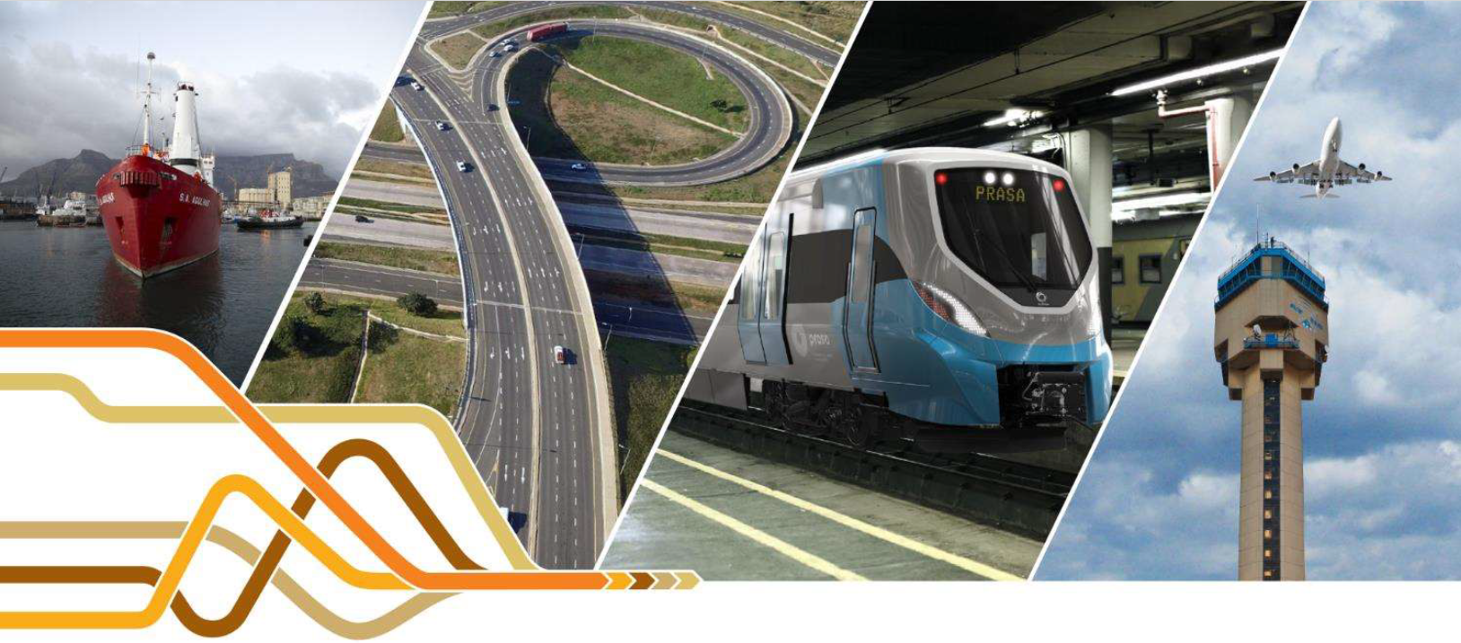
Technical Information:
SANS/ISO 55000 Asset Management System (AMS) & SANS1393 Construction Management System (CMS)
Road Maintenance Forum, 17 July 2024

Slide 2
ABOUT ICCASA
The Industry Compliance and Certification Authority of South Africa is a SANAS and IAF accredited Certification Body offering internationally accredited and accepted ISO Certification.
ICCASA is committed to assisting South African industries to gain valuable training and certification which is aligned to internationally accepted standards.
ISO 55001 training and certification has been rolled out by ICCASA for industry and government clients.
ICCASA is committed to supporting and enabling industry development through collaborative skills capacitation initiatives that focus on competence development and delivering knowledge transfer toolkits for effective industry skills capacitation.
Contact Jerry Ramdunee: jerry@iccasa.co.za.

Slide 3

ICCASA PROJECT CORE TEAM
Mr Jerry Ramdunee - Project Team Leader
Dr R. Milford
Dr M. Holtzhausen
Advocate S. Chettiah
Ms Y. Ndlovu
Mr S. Subroyen
Dr N.Khoza
Mr X. Mpahlwa

Slide 4
Overview
ISO/SANS 55001
SANS 1393

Slide 5
Definitions (ISO 55000)
Management System: set of interrelated or interacting elements of an organisation to establish policies and objectives and processes to achieve those objectives
Asset management system: A management system whose function is to establish the asset management policy and objectives, as well as processes and organisational arrangements inclusive of structure, roles and responsibilities to achieve asset management objectives

Slide 6
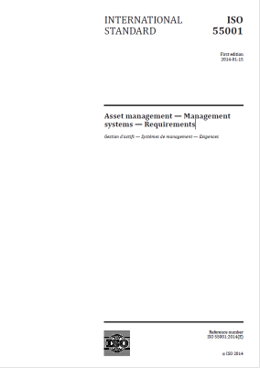
ISO/SANS 55001: Asset management - Management systems - Requirements
1. Scope: This International Standard specifies requirements for an asset management system within the context of the organization
4. Context of the Organisation
5. Leadership
6. Planning
7. Support
8. Operation (of AMS)
9. Performance evaluation
10. Improvement

Slide 7
ISO/SANS 55001: 9 Performance evaluation
9.1 Monitoring, measurement, analysis and evaluation
The organization shall determine:
a) what needs to be monitored and measured;
b) the methods for monitoring, measurement, analysis and evaluation, as applicable, to ensure valid results;
c) when the monitoring and measuring shall be performed;
d) when the results from monitoring and measurement shall be analysed and evaluated.
The organization shall evaluate and report on
— the asset performance;
— the asset management performance, including financial and non-financial performance;
— the effectiveness of the asset management system.
The organization shall evaluate and report on the effectiveness of the processes for managing risks and opportunities.
The organization shall retain appropriate documented information as evidence of the results of monitoring, measurement, analysis and evaluation.
The organization shall ensure that its monitoring and measurement enables it to meet the requirements of 4.2.

Slide 8
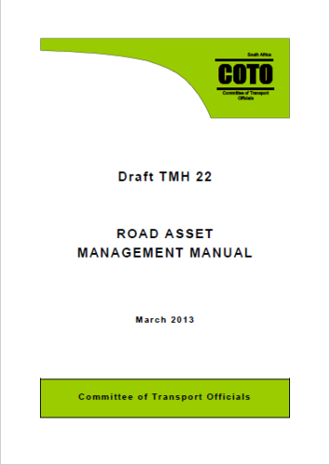
TMH22 (Draft 2013)
This manual is the official requirement for the Road Asset Management of the South African road network
It provides guidance to National, Provincial and Municipal Road Authorities on the methodology according to which the management of the existing road network must be undertaken
TMH22 provides a template, guidance and methodologies on the manner in which the road infrastructure assets should be managed

Slide 9
TMH22
TMH22
A: General and Organisation
B: Inventory Data
C: Asset Valuation
D: Usage and Condition Data
E: Indices
F: Situational Analysis
G: Needs Determination
H: Asset Management Plans
I: Feedback Loop
J: Appendices

Slide 10
TMH22 & ISO 55001
TMH22
ISO 55001
A: General and Organisation
B: Inventory Data
C: Asset Valuation
D: Usage and Condition Data
E: Indices
F: Situational Analysis
G: Needs Determination
H: Asset Management Plans
I: Feedback Loop
J: Appendices
4. Context
5. Leadership
6. Planning
7. Support
8. Operation (of AMS)
9. Performance evaluation
10. Improvement

Slide 11
TMH22: Appendix J-1 & ISO 55001
TMH22 APPENDIX J-1
ISO 55001
4. Organisational Context
5. Leadership
6. Planning
7. Support
8. Operation
9. Performance Evaluation
10. Improvement
11. Benefits Foreseen
12. Policy
4. Context
5. Leadership
6. Planning
7. Support
8. Operation (of AMS)
9. Performance evaluation
10. Improvement

Slide 12
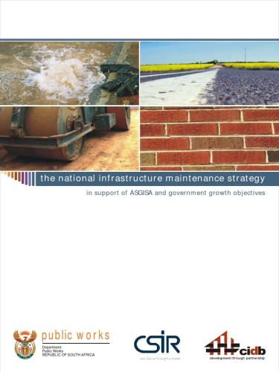
NIMS: National Infrastructure Maintenance Strategy (2008)
The strategy (NIMS) was approved by Cabinet in 2008
  The overall aim of the NIMS is the improved maintenance of public sector infrastructure in South Africa
Vision: That sound infrastructure asset management planning will be undertaken by all public sector institutions, and plans will be adequately resourced and implemented, so that service delivery will be sustained

Slide 13
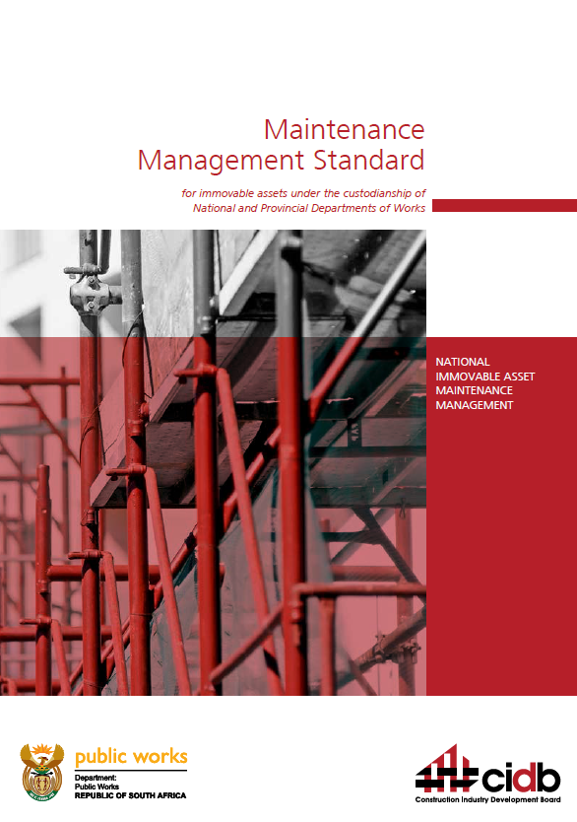
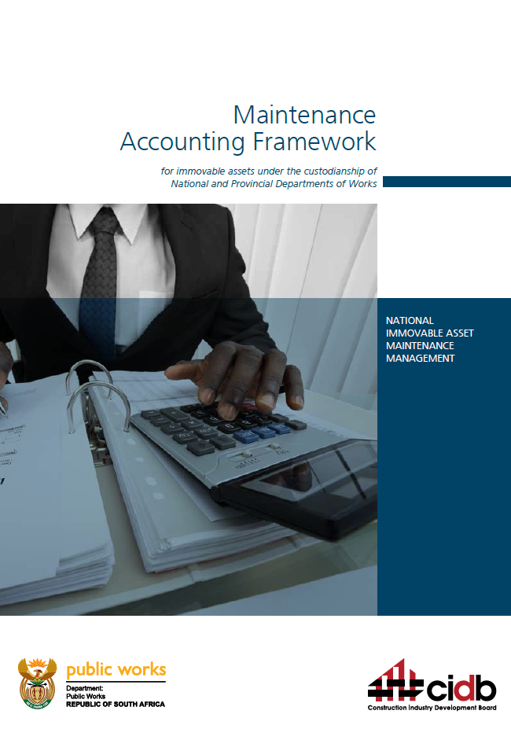
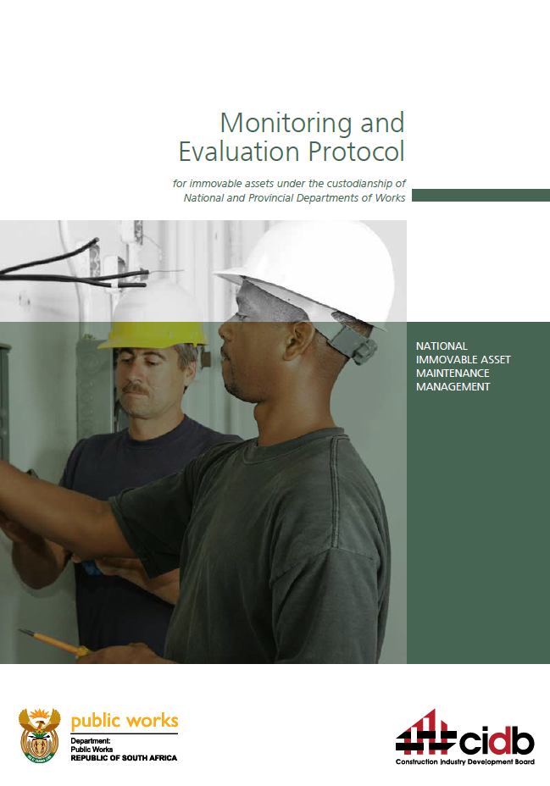
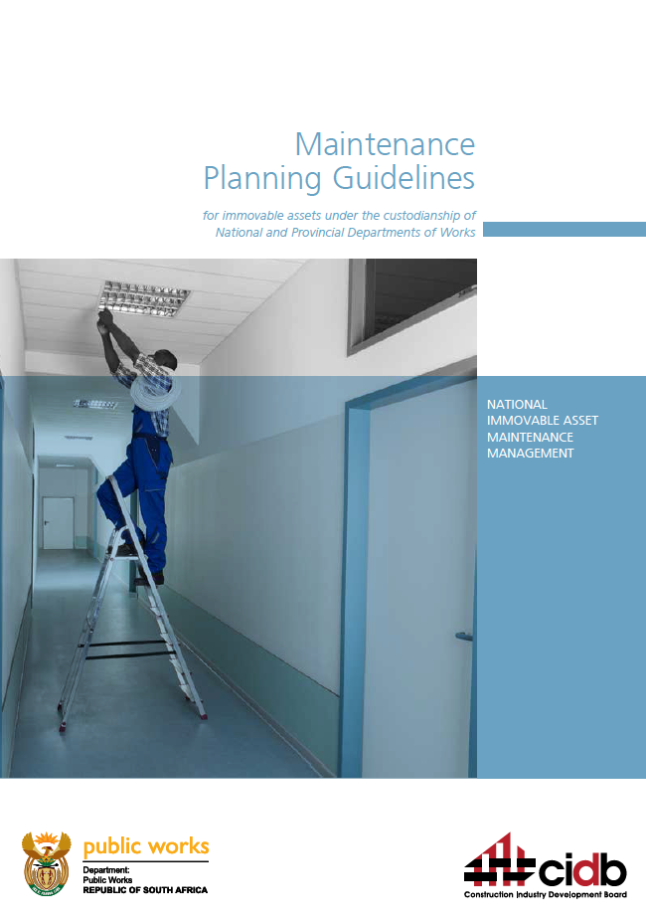
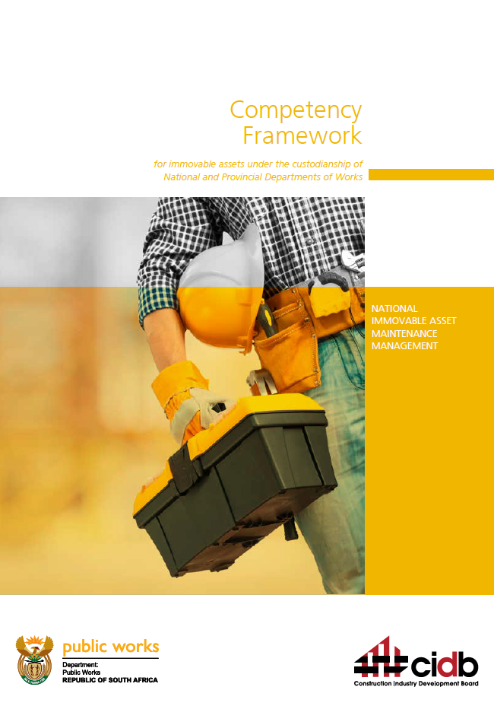
National Infrastructure Asset Maintenance Management (NIAMM) Framework (2017)
The NIAMM Framework includes six documents:
  NIAMM Standard
  NIAMM Accounting Framework
  NIAMM Monitoring and Evaluation Protocol
  NIAMM Planning Guidelines
  NIAMM Competency Framework
  Contractor Development through the Maintenance Industry

Slide 14

The NIAMM Standard
Part A: Purpose, Definitions & Scope
Part B: Core Requirements for Asset Care
  Asset Care Objectives, Strategies and Planning
  Maintenance of the Value Vested in Immovable Asset Portfolios
  Maintenance Delivery
  Incident Responses
  Risk Management
  Asset Rationalisation and Portfolio-level Optimisation
  Management Review, audit And Assurance
Part C: Enabling Requirements

Slide 15
NIAMM: 5.1 BUDGETING FOR MAINTENANCE OF IMMOVABLE ASSET PORTFOLIOS
5.1.1 Each entity should make sufficient budget provision for the maintenance of its immovable assets as per its approved asset management plans throughout the life of assets and shall furthermore undertake all reasonable effort to ensure full implementation of maintenance activities on an annual basis.
5.1.2 Further to 5.1.1 above, budgeting for asset maintenance shall be done on the basis of the demonstrated estimated current costs involved in achieving stated maintenance objectives. Budgeting shall not be based on historic budget provisions or some normative allocated percentage of the total operating budget.
5.1.3 In the event that insufficient budget is available for maintenance, or that such budget is not fully spent in a financial period, the entity shall record the amount of deferred maintenance in its annual financial statements, and shall furthermore:
  a. indicate the impact of insufficient spending on maintenance on the useful life expectations of assets; and
  b. indicate whether the lack of spending on asset maintenance has affected business operations, commitments to customers and/or legislative requirements regarding the availability of asset-based services, and operating income projections.

Slide 16
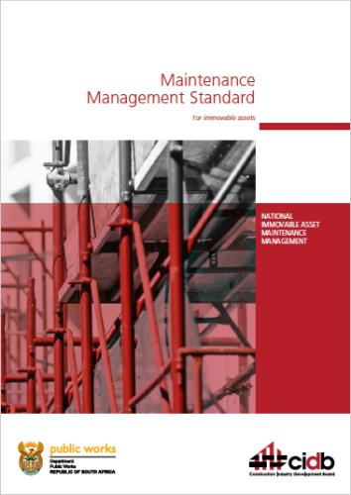
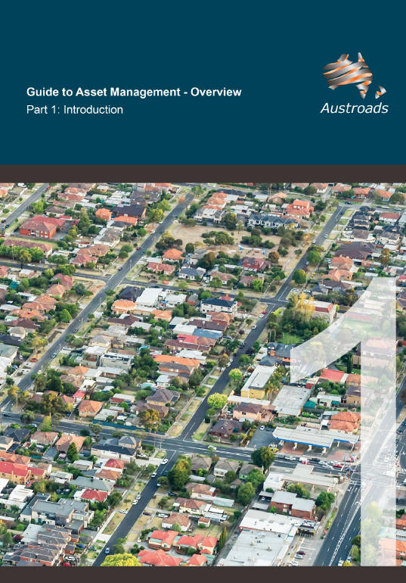
Towards ISO 55001

Slide 17
TMH22: Asset Management Maturity
Level I systems are acceptable in smaller municipalities where …. these should be implemented by 2014
Road authorities in South Africa should initially aim at Level II asset management for all their formal and regularly maintained roads to satisfy basic Treasury requirements and meet the basic needs of all stakeholders
More advanced Level IV asset management should be practiced for higher classes of road as is the case for example with SANRAL that manages most of the Class 1 roads while lower levels of asset management will generally be satisfactory for lower classes of roads

Slide 18
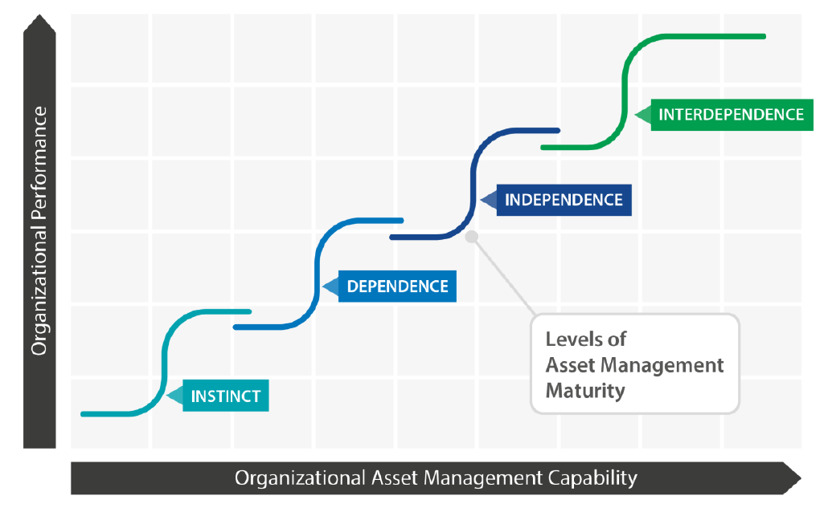
Asset Management Maturity (GFMAM)

Slide 19
TMH22 : Asset Management Level / Detail
Section | Level I | Level II | Level III | Level IV
Policy
Inventory
Condition and Usage | Visual evaluations of condition of each road. Traffic counts at selected positions | Detailed, objective visual evaluations of each road and bridge with some instrument measurements. Traffic counts cover entire road network on a regular basis | Integrated visual and instrument evaluations taken at the minimum frequencies Traffic count histories to reliably project future volumes | Reliable and credible condition and usage data that is used to accurately determine excess user costs and predict future excess user costs and related risks
Decision Support
Valuation
Management Plans
Feedback Loop

Slide 20
Accreditation & Certification
ISO 17021-1:2015 Conformity assessment - Requirements for bodies providing audit and certification of management systems - Part 1: Requirements
  Certification of Management System under SANAS Conformity Assessment Body (CAB)
  Scope ISO 55001
  Certification Body e.g. ICCASA
ISO 17024:2012 Conformity assessment - General requirements for bodies operating certification of persons
  Certification of Auditors under SANAS Accredited Body (CAB)
  Scope ISO 55001
  Southern African Auditing and Training Certification Authority (SAATCA)

Slide 21
Accreditation
ISO 17024 Conformity assessment - General requirements for bodies operating certification of persons
  Useful for personnel of custodian bodies to be accredited or have exposure under ISO 17024 Scope ISO 55001

Slide 22
Road Asset Management System: A Journey (iv)
It is a long journey:
  to manage assets well and derive value – in line with TMH22
  to deriving benefits from a RAMS
  to ISO 55001 Certification
  to performance improvement

Slide 23
Progressing Towards ISO 55001 – Alignment or Certification? (AGAM02)
Before deciding to become certified to ISO 55001, several options should be considered:
limited certification – for a particular asset group/portfolio/sub-network
alignment without certification
partial alignment – for a particular asset group/portfolio/sub-network or particular requirements considered important to the agency
taking no action

Slide 24
Progressing Towards ISO 55001 – Alignment or Certification? (AGAM02)
Understand strengths and weaknesses:
Gap analysis against the specific requirements of ISO 55001, identifying where improvements or changes are needed
  gap analysis could be conducted in-house or by an independent external party
  e.g. gap analysis tool in TMH22
Establish or update business processes and make other improvements as required
  some improvements may be straightforward, while others could be time-consuming, require significant management commitment, change management and investment, or all of these
Once the necessary changes and improvements have been made, assess the level of alignment with ISO 55001 and determine whether or not or when to seek certification
  assessment could be conducted in-house or by an independent external party
Final step is the third-party certification process conducted by an ISO 55001 Certification Body - ICCASA

Slide 25
Overview
ISO/SANS 55001
SANS 1393

Slide 26
SANS 1393
In terms of the CIDB Best Practice Contractor Recognition System (part of the BUILD Programme), the Board has identified certification to SANS 1393 Construction Management System as best practices for contractor enterprises in Grades 5 to 9
SANS 1393 specifies requirements for a construction management system (CMS) to be used for construction work
  A CMS is a framework of processes and procedures used by an organization to better control its construction risks and to improve its performance
  Such management systems play a very important role in promoting performance improvement and in delivering better value to clients

Slide 27
SANS 1393 Training and Certification Audit
cidb has currently appointed ICCASA to roll out SANS 1393 training and certification audits to contractors

Slide 28
SANS 1393 Certification
ISO 17021-1:2015 Conformity assessment - Requirements for bodies providing audit and certification of management systems - Part 1: Requirements
  Certification of Management System under SANAS Conformity Assessment Body (CAB)
  Scope SANS 1393
  Industry Compliance and Certification Authority of South Africa (ICCASA)
ISO 17024:2012 Conformity assessment - General requirements for bodies operating certification of persons
  Certification of Auditors under SANAS Accredited Body (CAB)
  Scope SANS 1393
  Southern African Auditing and Training Certification Authority (SAATCA)

Slide 29

Questions &
Comments

