Slide 1
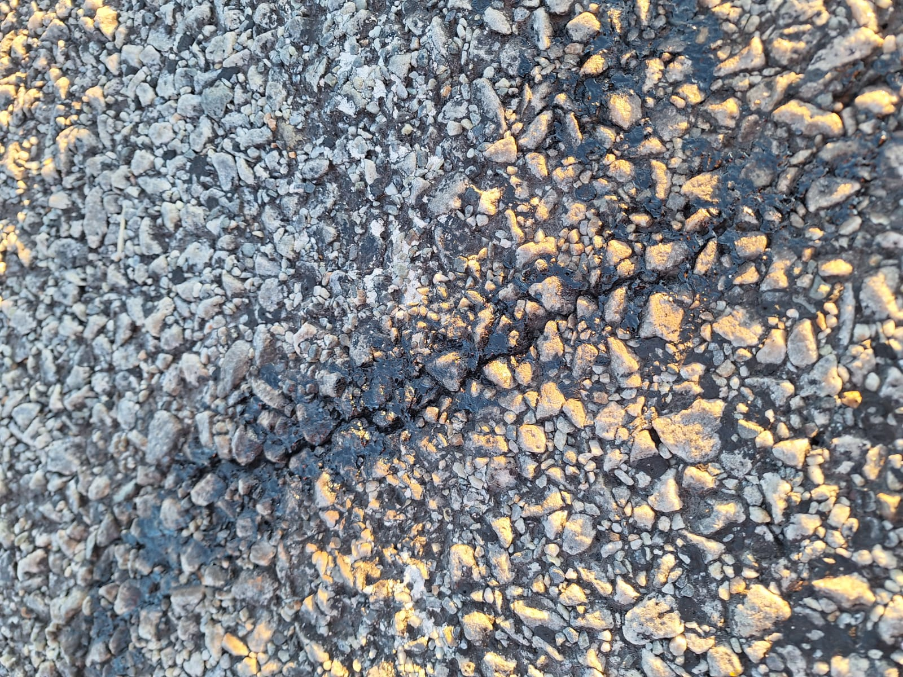
Title: Effective Crack Sealing for Road Maintenance
Presenter : Larusha Gramni
Organisation : TOSAS

Slide 2
Crack Sealing Procedures
Crack Assessment
Cracks 0-1mm
Cracks 0-3mm
Cracks >5mm
Crack Sealant Selection
Conclusion
Evaluate Crack Widths and Severity:
Cracks 2-4mm
Application
Notes:
We will examine the Importance of Crack Sealing, conduct Crack Assessments to evaluate severity and width, and explore the Selection of Appropriate Materials for maintenance.
Objective: To provide a comprehensive understanding of crack sealing and its impact on road longevity

Slide 3
Importance of Crack Sealing
Definition:
Crack sealing is the process of applying a bituminous sealant to cracks in the pavement to prevent water and debris from entering.
Why It Matters:
Maintain and extend the lifespan of the roads
Cost-effective maintenance strategy

Slide 4
What happens to a road?
Seal
Base
Subase
Roadbed
“Pavement”

Slide 5
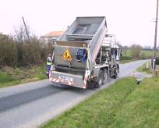
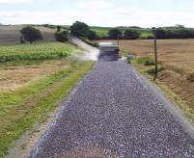
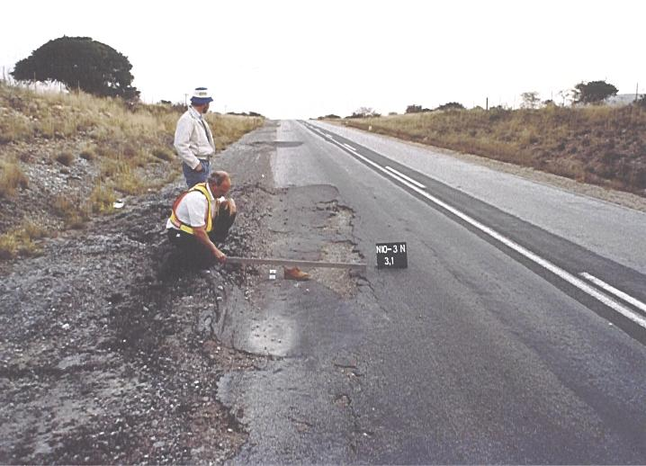
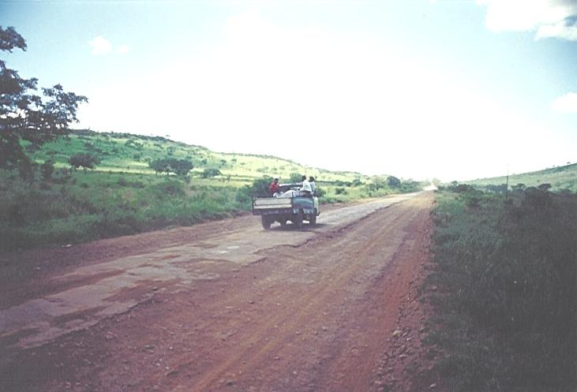
What are the maintenance cost implications / km ?
Could be
a small %
Let's say
R Y / km
Could be
Up to 6 x Y
Could be
Up to 18 x Y
Still ok, but needs attention
Fair, but needs resealing
Poor, patching & resealing
Very poor
Selected
Reseal
Patch/Seal
Rebuild

Slide 6
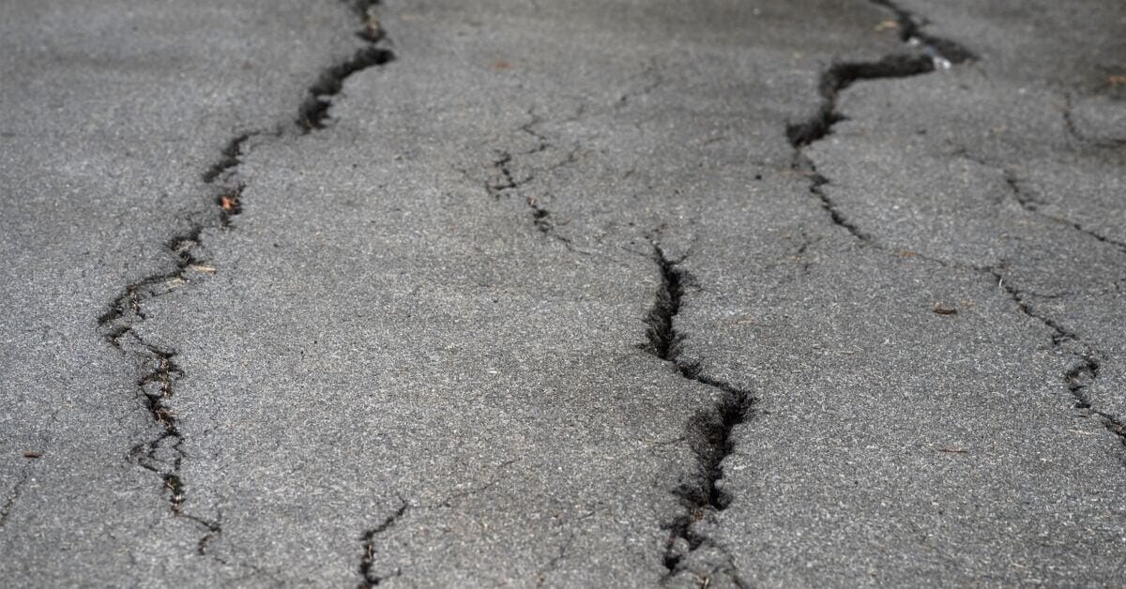
Cracks in Pavement
Common Types:
Transverse Cracks
Longitudinal Cracks
Block Cracks
Edge Cracks
Reflective Cracks
Notes:
Different types of cracks commonly found in roads:
Transverse Cracks:
Cracks that run perpendicular to the direction of traffic flow. They are typically caused by thermal expansion and contraction of the pavement.
Longitudinal Cracks:
Cracks that run parallel to the direction of traffic flow. These can be caused by poor joint construction, inadequate drainage, or heavy traffic loads.
Block Cracks:
Cracks that divide the pavement into rectangular pieces resembling a block pattern. They are caused by shrinkage of the asphalt concrete due to temperature fluctuations.
Edge Cracks:
Cracks that develop parallel to and within approximately 0.3 meters of the pavement edge. They are often caused by inadequate support at the pavement edge or lack of proper drainage.
Reflective Cracks:
Cracks that propagate from the existing cracks or joints in the underlying pavement layers up into the new overlay or surface treatment. They occur due to movement or deformation in the lower layers being transferred to the surface.

Slide 7
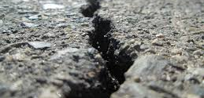
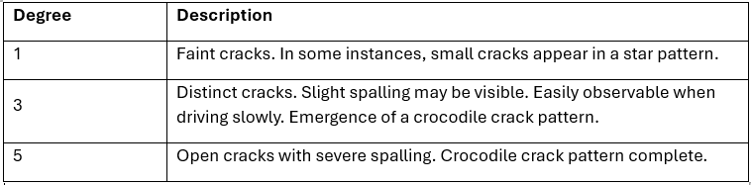
Degrees of Surfacing Cracks
Notes:
Inspecting cracks on roads is crucial to assess their severity and width, which helps determine appropriate maintenance actions. Here’s a description based on the severity and width of cracks:
Faint cracks:
These cracks are initially small and may appear in a star pattern. They are often faint and not fully developed, indicating early signs of pavement distress. At this stage, they may not significantly affect the structural integrity but should be monitored closely.
Distinct cracks:
At this stage, cracks become more noticeable and may exhibit slight spalling, where small pieces of pavement start to break away. They are easily visible when driving slowly and may start forming a crocodile crack pattern, resembling interconnected scales.
Open cracks with severe spalling:
These cracks are wide open and severe, with significant spalling where larger sections of pavement have broken away. The crocodile crack pattern is fully developed, resembling a network of interconnected cracks across the pavement surface. This stage indicates advanced pavement distress and requires immediate attention to prevent further deterioration.
Inspecting and categorizing cracks based on severity and width helps road maintenance professionals prioritize repairs and interventions effectively, ensuring safety and extending the lifespan of the pavement infrastructure.

Slide 8
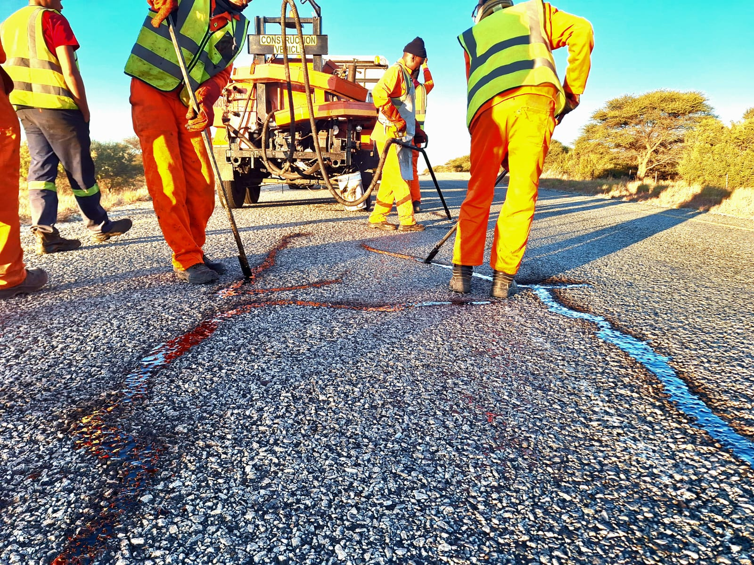
Cold applied
Hot applied
C-R1 - Crumbed Rubber
TYPES OF CRACK SEALANT
FOR PREVENTATIVE MAINTAINACE
Fog Seal
SS 60 with 8% SBR Latex
CC-E1 - SBR Latex
C-E1 – SBS / Warm Mix
C-R2 - Crumbed Rubber
Notes:
The types of crack sealants available in the industry for maintenance solutions include:
Cold Applied:
Fog Seal
SS 60/8
CC-E1 - SBR Latex
Hot Applied:
C-E1 – SBS / Warm Mix (requires less heating and emits less gas)
C-R1 - Crumbed Rubber
C-R2 - Crumbed Rubber
These sealants are utilized based on their application requirements and performance characteristics, ensuring effective crack sealing and pavement preservation.

Slide 9
Properties of Suitable Crack Sealant
Key Characteristics:
Adheres to crack walls
Elongates to maximum crack opening and recovers without rupture
Expands and contracts over a range of temperatures without rupture or delamination
Resists abrasion and damage from traffic
Property | Unit | Test Method | Class
 |  |  | Fog Seal | SS 60/8 | CC-E1¹ | C-E1 | C-R1 | C-R2
Softening point | °C | MB-17 | ≥47 | ≥48 | ≥70² | ≥80 | 55-65 | 65-70
Elastic recovery @ 15°C | % | MB-4 | 0 | ≥50 | ≥50² | ≥80 | - | -
Dynamic viscosity @ 190°C | dPa.s | MB-13 | - | - | - | - | 20-40 | -
Dynamic viscosity @ 170°C | dPa.s | MB-13 | - | - |  |  |  | 10-40
Dynamic viscosity @ 165°C | Pa.s | MB–18 | - | - | - | ≤0,65 | - | -
Dynamic viscosity @ 25°C | Pa.s | MB–18 | - | - | ≤0.8 | - | - | -

Slide 10
Selection of Binder for Different Crack Widths or Severity
Cracks 0-1mm:
Use a low-viscosity emulsion or bitumen-based sealant.
Example: Use a fog seal.
Cracks 0-3mm:
Use a medium-viscosity elastomeric sealant.
Example: SS 60/8
Cracks 2-4 mm:
Use a high-viscosity, flexible sealant capable of handling larger movements
Hot applied elastomer modified C-E1
Cracks >5 mm:
Example: Hot applied bitumen rubber C-R1 / C-R2.
Emulsion elastomer modified CC-E1
Emulsion elastomer modified CC-E1.

Slide 11
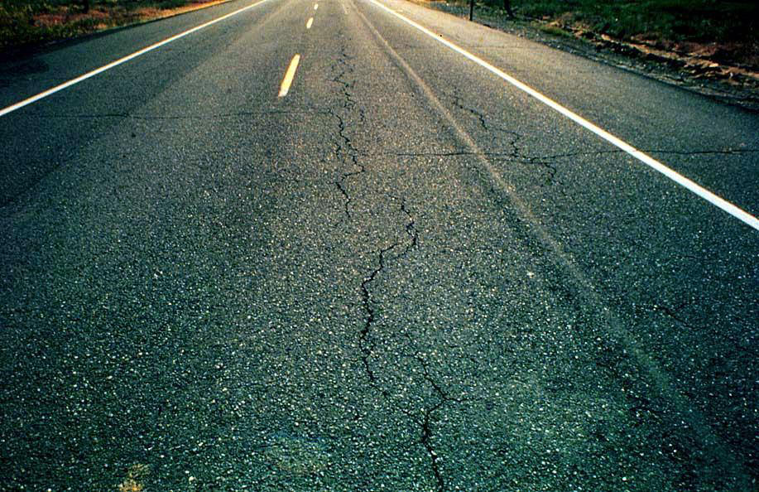
Prior to Application
Surface Preparation
Ensure that the surface has been cleaned from debris through means of Vacuum sucker
Importance of Adhesion
Heating
Blowing of air to remove dust “ Do not make use of a broom”
If no torch is available , Bonding agent can be used
Crack Routing
Notes:
Vacuum Sucker :Use a vacuum sucker to thoroughly clean the surface from debris. This ensures loose materials are completely removed, preventing interference with the sealant adhesion.
Air Blowing:Blow compressed air across the surface to remove any remaining dust particles. This step is crucial for achieving a clean and dry surface, optimizing the effectiveness of the crack sealing process.
Crack Routing:Rout or widen the cracks using specialized equipment. This creates a reservoir that allows the sealant to adhere better and ensures it can penetrate deeper into the crack for a more effective seal.
Heating:Heat the crack using a torch or other heating equipment to soften the asphalt. This step helps the sealant flow more easily into the crack, ensuring complete filling.
Bonding Agent :Apply a bonding agent or primer to the cleaned and heated surface before applying the sealant. This enhances adhesion between the sealant and the pavement, particularly useful when heating with a torch isn't feasible.

Slide 12
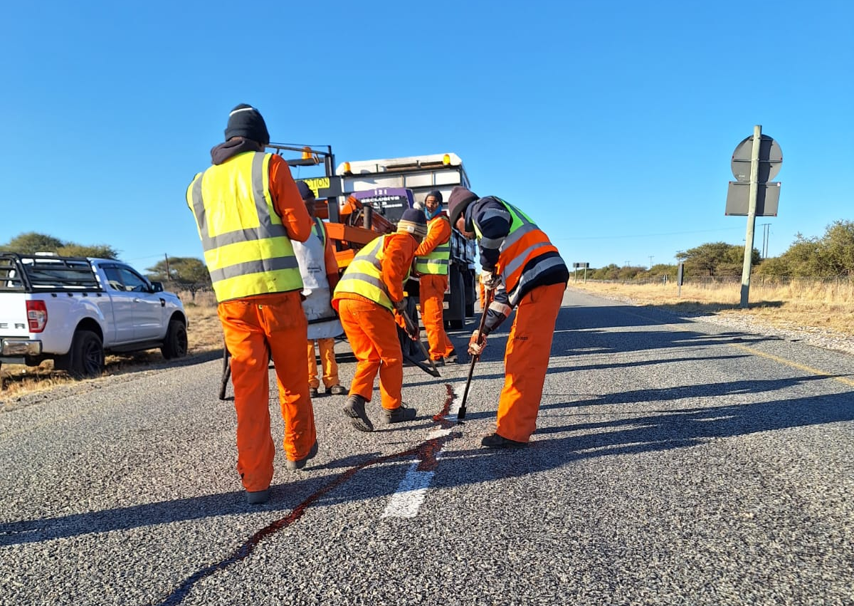
Application of Sealant
Placement:
  Ensure sealant is applied evenly into the prepared cracks.
  Avoid overfilling to prevent tracking and ensure a smooth finish.
Tools:
  Use a crack sealing machine for uniform application.
  For smaller cracks, handheld applicators can be used.
Post-Application
Inspection:
  Check for proper adhesion and coverage.
  Ensure sealant is properly cured before opening to traffic.
Maintenance:
  Regularly inspect sealed cracks for any signs of failure or new cracking.
  Reapply sealant as necessary to maintain pavement integrity.

Slide 13
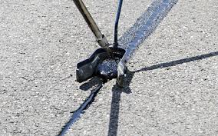
Best Practices for Crack Sealing and Filling
Tips:
Proper crack preparation
Selection of appropriate materials
Timing and weather considerations
Notes:
Selection of Appropriate Materials:
Sealant Type: Choose a sealant appropriate for the climate and traffic conditions. Consider factors such as flexibility, durability, and compatibility with the pavement material.
Apply crack sealing during moderate temperatures . Avoid extreme heat or cold, which can affect sealant application and curing.
Weather Conditions: Ensure the surface is dry during application to prevent moisture from affecting adhesion and curing of the sealant.

Slide 14
Conclusion
Summary of Key Points:
Importance of crack sealing
Key characteristics of suitable materials
Benefits of proper application
Call to Action:
The need for regular maintenance and proactive crack treatment
Notes:
Crack sealing and filling are vital for preserving road integrity by preventing water damage, minimizing further deterioration, and extending road lifespan. Effective use of flexible, durable materials, applied correctly, ensures cost-effective maintenance and safer road conditions.

Slide 15
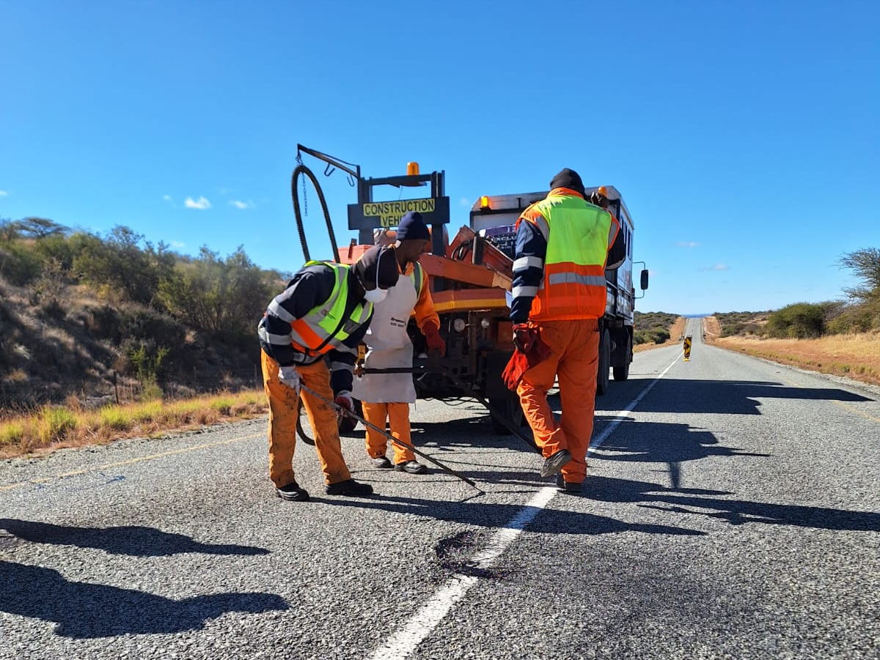
THANK YOU

